Slide 1
Jolt Elevator Storyboard 2

Slide 2
Remote monitoring
technician can register a machine as a ‘friend’
will now be included in
scheduled periodic updates
heartbeats = compact summary of status / key telemetry values
frequency perhaps proportional to ‘severity’ analysis
push notification to dashboard (or tiles, if the OS supports them)
raw sensor values, or processed derivatives
alerts
any ‘social’ chat on this device
i.e. just like following hash tags on twitter

Slide 3
calls
when customer rings in an issue
Help desk creates a ‘call’
when Jolt spots a problem,
it generates a ‘call’
in either case
‘Call’ includes information about machine, issue etc.,
Call exists in native CRM system
“alert” is created in Jolt
our system will send out notifications to machine ‘friends’ and proximity …
changes to “alert” are reflected back to CRM
callback actions (urls) assigned to the alert object
these may trigger other workflow e.g. create a ticket…
Notes:
Concept here is to separate the CRM call/ticket implementation from our system. CRM can cerate an alert and assign some callback URLs.
Creation/changes to alert will notify appropriate jolt users. If user chooses action, appropriate callback url is called.

Slide 4
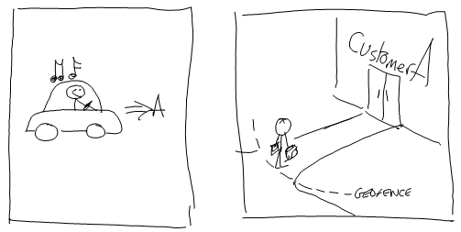
It’s a beautiful day…
Customer B
Bob is in the car, on his way to first customer A …
Fred is at Customer B
He has tripped the geofence that has been setup for this customer location
Jim is at customer C

Slide 5
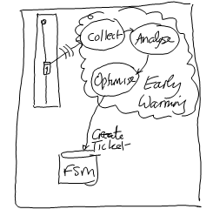
… but there is trouble brewing …
one of the elevators in the skyscraper is experiencing issues
Bob has visited this site and worked on this elevator before
he has marked it as a ‘friend’ because he was concerned about an issue with the door motor
he wants to keep an eye on it
analysis
analytics phase is tracking issues and spots a potential failure pattern
action
optimise phase decides what to do

Slide 6
Notifications
+ Notifications (updates) to ‘friends’
+ Notifications (alerts) to proximity + ‘friends’
remote monitoring updates
Bob has registered as a ‘friend’ of this elevator
he gets periodic status updates (heartbeats) – shown in his “waiting room” (dashboard)
Think of these as the machine writing its own biography, and we are getting daily rushes showing updates and, from Jolt, predictions of the future ☺
Notes:
Jim also gets the alert, not because he is in proximity, but because he has one of the spare parts that Fred needs.
The system could determine the most optimal place (and time) to meet to exchange parts before Bob goes to customer

Slide 7
Notifications
+ Notifications (updates) to ‘friends’
+ Notifications (alerts) to proximity + ‘friends’
alerts
optimiser creates ‘call’ – is put on CRM queue
alert sent out people “within proximity”, and all registered “friends”
Bob gets the alert, but he’s driving
Fred is on-site (proximity) so gets the alert
he opens the alert, reads the info
he has time, so accepts the ticket – it is taken off the queue
Jim is at customer C
he may not be in proximity but he happens to have the part in the van
if call gets to front of queue, ticket is created
manual/auto-assigned to Bob – scheduled visit next week
Notes:
Jim also gets the alert, not because he is in proximity, but because he has one of the spare parts that Fred needs.
The system could determine the most optimal place (and time) to meet to exchange parts before Bob goes to customer

Slide 8
alerts
when we receive the notification
we get a popup – “close” or “view”
I’m busy, click close
otherwise I open (view) it
notification it is a small data packet
2,3 lines of user-readable information
ID of the call object
when we open alert, connect to server to download more info
this gets me more information on the alert
recent telemetry data (detailed, say the last hour)
historical telemetry (less detailed)
service history (when was it last worked on, who did what)
I can choose to participate or reject the task based on what I read in the alert
participation might just add me to a conf call
I might be able create and assign a ticket
reject will notify others that I don’t want it
alert is updated, so others (including call center) get notified
Notes:
Acceptance of ticket may end up firing a url back at salesforce asking it to create and assign the ticket etc. – this information could be embedded in the alert object, meaning our system has no real idea what that step is, it just calls some url to trigger it.
The result of this action might update/delete the alert proxy object, and that might notify me and others as to what happens next.

Slide 9
Fred the technician could create the ticket
Alert object might include an action to support this
Help desk might create ticket
and assign to Fred ?
He’s on-site, so does he get it straight away?
or assign to Bob
Who is scheduled to come in next week
Notes:
Do we need another sub-usecase to deal with this i.e. download/patching of data for new ticket delivered when I’m on site / on the move

